Slide 1

EY Techathon 6.0 Executive Summary
Date of submission:

Slide 2
Quick introduction

Slide 3
Tell us about yourself. Highlight a technical skill or skills each member brings to the team
01#
Krishna Sai Velidanda
Experienced in agentic AI applications
Winner in multiple hackathons
Researcher in major ML related domains.

Slide 4

Problem Statement:
The NBFC wants to improve its sales success rate for personal loans by using an AI-driven conversational approach.
Why it matters:
90%+ of India’s market expects instant, conversational, multi-lingual financial engagement
Top NBFCs need a scalable, compliant, reliable solution to deliver genuine sales uplift
Industry Challenge: Large NBFCs are struggling to convert qualified website leads into loan sales at massive scale due to:
Inflexible, impersonal chatbots—no empathy, no upsell, high abandonment
Fragmented loan journeys—manual KYC, slow underwriting, missed cross-sell
Multilingual digital population excluded by English-only tools
High regulatory and security hurdles (data localization, compliance, audit)
Lack of explainability in current GenAI solutions
Strategic Goal: Redefine the loan sales process with an AI workforce that is more persuasive, more compliant, and more scalable than any human team in India—delivering seamless, personalized, auditable, and omnichannel journeys in every Indian language, with industry-leading productivity, trust, and profitability.
Problem statement you wish to address and why (Provide detailed explanation)

Slide 5
Next-Gen Multi-Agent Architecture:
Digital Persona (Face+Voice):
Photorealistic video avatar (Tavus) & cloned voice (ElevenLabs), always-on, 32+ languages.
Deployed across channels: web, app, WhatsApp, branch kiosks, and IVR
Custom BFSI LLM:
Trained on actual Indian BFSI language, regulatory FAQ, compliance briefs, RBI circulars, and multilingual corpora
Operates as “Master Sales Agent”: deep customer empathy, cross-sell, basic-to-advanced product inquiry, transparency in reasons for all outcomes (explainable AI), proactive risk prompts
Specialist Worker Agents:
KYC agent: Real-time CRM/eKYC/AML screening, connected to secure, India-hosted API endpoints
Underwriting agent: Adaptive risk engine (on-prem/private cloud with modular credit model plugins), precision EMI calculations
Document agent: Real-time OCR (Google DocAI, compliant models), intelligent doc guidance, vision-language QA
Sanction letter agent: Generates multilingual PDF, e-sign workflows, WhatsApp/email/app delivery
Orchestration:
State-machine workflow with “pause and resume later” (multi-session, multi-device), real-time escalation to human RMs for VIP/complex or compliance exceptions
Output Form Factor:
Photorealistic video/chat avatar
Mobile, web, WhatsApp, in-branch kiosk
32+ languages, voice and text
Key User Group:
Personal loan seekers from digital campaigns and existing customers
User Journey: User → AI Persona → Master Agent → [KYC/Verification] → [Credit/Underwriting] → [Doc Handling] → [Approval/Negotiation/Feedback] → [Sanction Letter/Next Steps]
Describe your approach to solving the problem
(Describing Output Form Factor [Mobile App/Web App/Faceless Agent Execution/Chat Bot/Voice Bot Etc], Key User Group, User Journey.

Slide 6
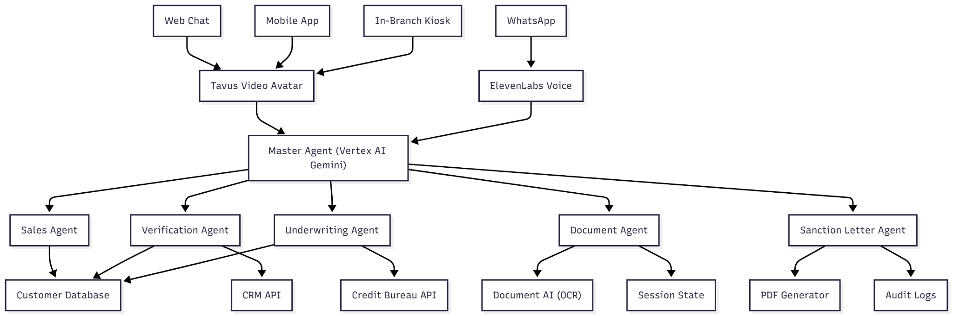
Planned solution design
(Diagram and Key Technology components planned for use)

Slide 7
Immediate Value:
24/7 digital sales agents, superior to top 1% human performers, always consistent
Triples conversion rates on digital campaigns, drives 19,000%+ ROI in first year
100x scale—no incremental hiring for surges, year-end demand, or new regions
Empowers every Indian customer with first-language access, emotion, and trust—overturning digital exclusion
Key Strategic Moats:
Proprietary BFSI-trained LLM: Regulatory intelligence, domain vocabulary, cost-saving on inference/GPU
Secure, India-localized AI stack—no “hallucination” or privacy gaps
Responsible, transparent, explainable by design—tomorrow’s compliance today
Benefits:
24/7, always-consistent loan sales persuasion
10–15× digital conversion uplift; cost per loan ₹100–200 (down from ₹5,000)
Ultimate Impact: Building digital trust, profitability, and inclusion—creating India’s best-in-class, most reliable and lovable lending AI workforce with the broadest reach and most responsible AI foundation ever implemented in the Indian BFSI sector.
Potential Benefit from your proposed solution
(Describe in detail the kind of benefit can be planned through your solution, Explain key Matrix, Potential Return on Investment)

Slide 8








Powered by India's leading enterprises
Thank you for your attention!

Slide 9


Ernst & Young LLP
EY | Building a better working world
EY is building a better working world by creating new value for clients, people, society and the planet, while building trust in capital markets.
Enabled by data, AI and advanced technology, EY teams help clients shape the future with confidence and develop answers for the most pressing issues of today and tomorrow.
EY teams work across a full spectrum of services in assurance, consulting, tax, strategy and transactions. Fueled by sector insights, a globally connected, multi-disciplinary network and diverse ecosystem partners, EY teams can provide services in more than 150 countries and territories.
All in to shape the future with confidence.
EY refers to the global organization, and may refer to one or more, of the member firms of Ernst & Young Global Limited, each of which is a separate legal entity. Ernst & Young Global Limited, a UK company limited by guarantee, does not provide services to clients. Information about how EY collects and uses personal data and a description of the rights individuals have under data protection legislation are available via ey.com/privacy. EYG member firms do not practice law where prohibited by local laws. For more information about our organization, please visit ey.com.
Ernst & Young LLP is one of the Indian client serving member firms of EYGM Limited. For more information about our organization, please visit www.ey.com/en_in.
Ernst & Young LLP is a Limited Liability Partnership, registered under the Limited Liability Partnership Act, 2008 in India, having its registered office at Ground Floor, Plot No. 67, Institutional Area, Sector - 44, Gurugram - 122 003, Haryana, India.
© 2025 Ernst & Young LLP. Published in India. All Rights Reserved.
This publication contains information in summary form and is therefore intended for general guidance only. It is not intended to be a substitute for detailed research or the exercise of professional judgment. Neither EYGM Limited nor any other member of the global Ernst & Young organization can accept any responsibility for loss occasioned to any person acting or refraining from action as a result of any material in this publication. On any specific matter, reference should be made to the appropriate advisor.

